Slide 1

Exploratory Data Analysis
21-Nov-2022

Slide 2
Background - Tips
Tips database is the record of the tip given by the customers in a restaurant for two and a half months in the early 1990s. It contains 6 columns such as total bill, tip, sex, smoker, day, time, size.

Slide 3
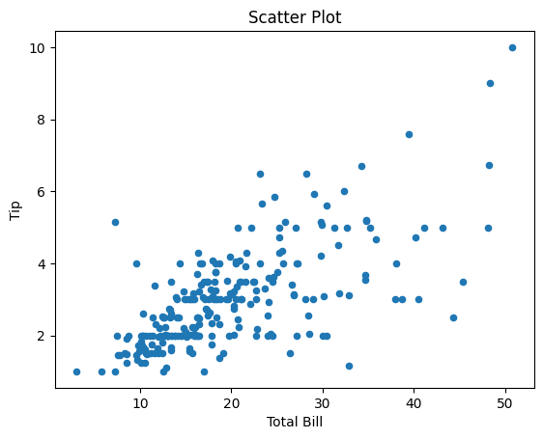
Tip Analysis based on Total Bill
This is Tip effect of the increase in the Total Bill.

Slide 4
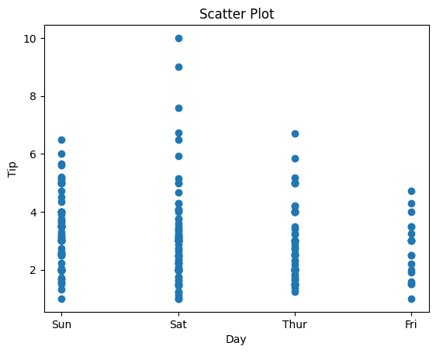
Tip Analysis based on Day
This shows the change in the tip compared to Sunday, Saturday, Thursday and Friday.

Slide 5
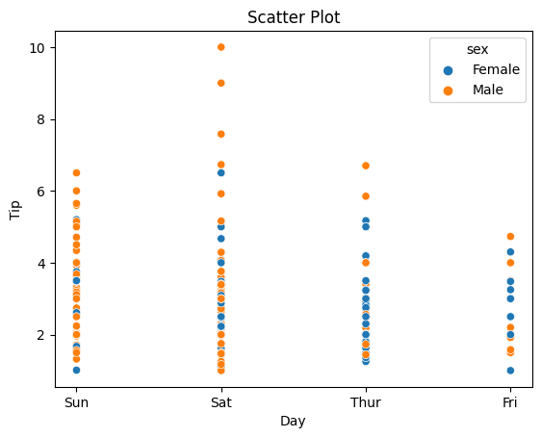
Tip Analysis based on Day and Gender
This shows the change in the tip compared to Sunday, Saturday, Thursday and Friday and indicates the genders in blue and orange.

Slide 6
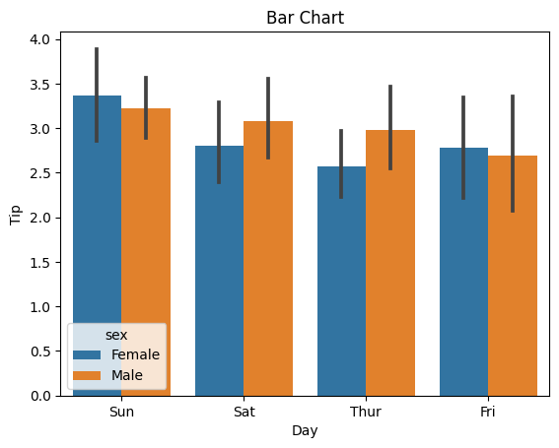
Tip Analysis based on Gender
This shows the change in the tip compared to Sunday, Saturday, Thursday and Friday and indicates the genders in blue and orange.

Slide 7
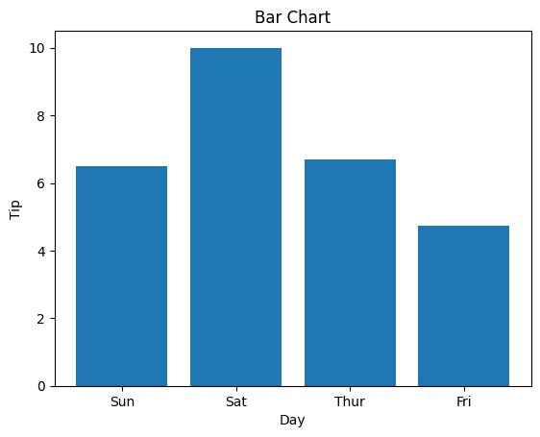
Tip Analysis based on Day
This shows the change in the tip compared to Sunday, Saturday, Thursday and Friday.

Slide 8
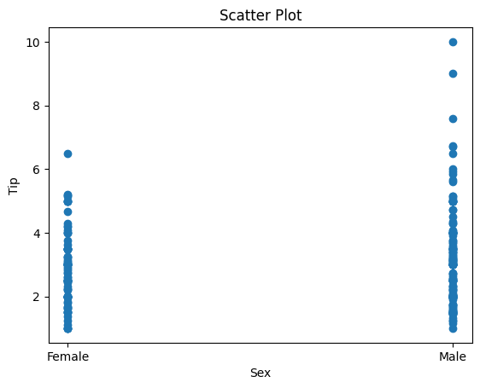
Tip Analysis based on Gender
This shows how much is tipped by gender.

Slide 9
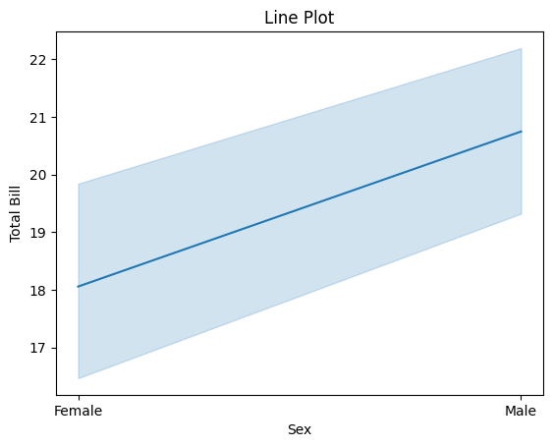
Total Bill analysis based on Gender
This shows that the total bill increases linearly from male to female.

Slide 10
Hypothesis
Is there a daily effect on tips?
In the restaurant, customers tipped the most on Saturday.
Does the gender factor matter?
The data show that males tip more.
What range is the tip usually in?
The customers prefer to tip between 10 and 20 at most.
Does gender have an effect on daily tipping?
Generally, males and females tip the most on Sunday.

Slide 11

Data Glacier
Thank You

